Slide 1
Multimodal Sentiment Analysis
Presented by: Aagya Pudasaini

Slide 2

Introduction
Sentiment analysis is a key task in Natural Language Processing (NLP), widely used in:
    Social media analytics
    Brand reputation monitoring
    Public opinion and trend analysis
With the growth of platforms such as Twitter, Instagram, and Facebook, users increasingly express opinions using both text and images.
Traditional sentiment analysis systems mainly rely on textual data, ignoring visual cues that often carry emotional meaning.
Advances in Deep Learning, particularly Transformers and Convolutional Neural Networks (CNNs), enable AI systems to process multiple data modalities simultaneously.
This project explores how multimodal learning can improve sentiment understanding by mimicking how humans interpret content holistically.

Slide 3
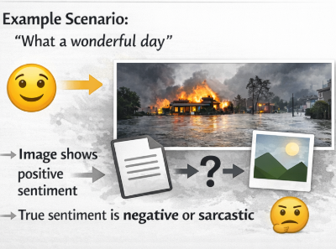
PROBLEM DEFINITION
Unimodal sentiment analysis models fail to capture the true emotional intent when sentiment depends on context beyond text.
Text alone can be:
      Ambiguous
      Sarcastic
      Misleading without visual reference
Existing models struggle to:
      Integrate high-dimensional image features with contextual text embeddings
      Maintain performance with limited labelled data
      Generalize across diverse social media scenarios
Core Research Problem:
How can textual and visual features be effectively fused to improve sentiment classification accuracy and robustness?

Slide 4
Dataset
Source: Public Multimodal Sentiment Dataset (Figshare Repository)
Contains: Image + caption pairs
Total Samples: ~3,594 image–text pairs
Sentiment Labels: Positive, Neutral, Negative
Annotation Type: Human-labelled sentiment classes
Motivation for Use: Suitable for evaluating multimodal sentiment fusion under limited data conditions

Slide 5
EXPLORATORY DATA ANALYSIS (EDA)
Text Analysis
    Average caption length: ~12 words
    Frequent sentiment-related terms identified via WordCloud
Image Analysis
    RGB intensity and brightness patterns vary across sentiment labels
Data Splitting
    Stratified Train / Validation / Test split
    Total dataset: 3594, Training set: 2875, Test Set: 719
    Ensured balanced class distribution

Slide 6
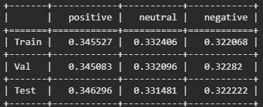
CLASS DISTRIBUTION CHECK

Slide 7
MODEL PARAMETERS & TRAINING SETUP
TEXT MODEL
IMAGE MODEL
TRAINING PARAMETERS
Embedding Size: 768
Max Token Length: 128
Pre-trained Transformer weights
  Input Size: 224 × 224 Pixels
  Pre-trained on ImageNet
  Feature extraction only
Optimizer: Adam
Epochs: 15
Batch Size: 32
Total Parameters ≈ 10.28M
Loss Function: Sparse Categorical Cross-Entropy
Regularization: Dropout (0.3)
Early Stopping applied

Slide 8
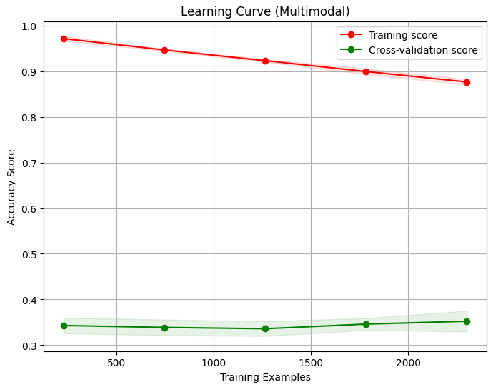
LEARNING
CURVE
Training accuracy: High (≈0.97 → 0.88)
Validation accuracy: Low and stable (≈0.33–0.35)
Large gap between training and validation curves
Indicates overfitting

Slide 9
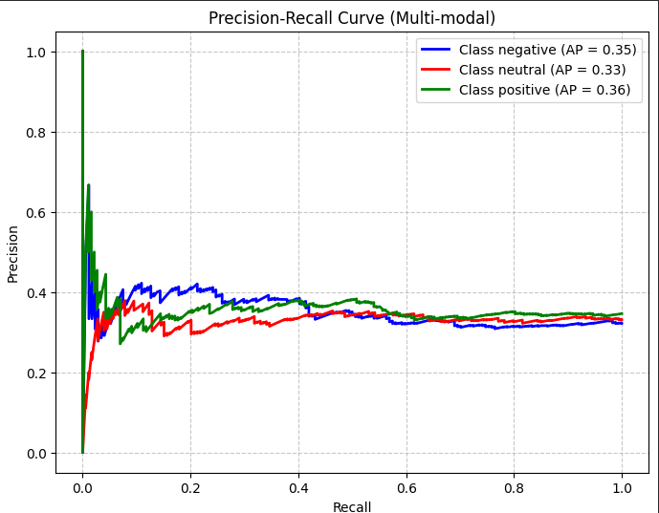
Precision-recall curve
Precision–Recall curve is useful for imbalanced datasets
Average Precision (AP):
  Negative: 0.35
  Neutral: 0.33
  Positive: 0.36
Low precision across recall range

Slide 10
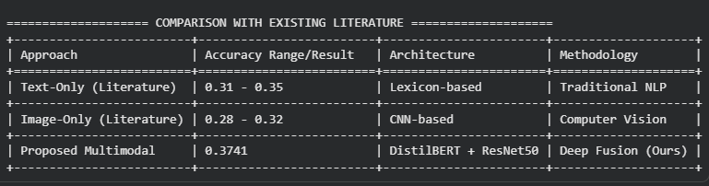
COMPARISON WITH EXISTING WORK

Slide 11
CONCLUSION
FUTURE WORK
Multimodal deep learning provides a more robust framework for sentiment analysis
Visual context significantly enhances understanding beyond text alone
Late fusion is effective but not optimal
Implement cross-attention transformers
Deploy real-time system using Gradio or Streamlit
Extend to video and audio modalities

Slide 12


